Slide 1


Andrew Gomoll
December 2022

Slide 2

Outline
Executive Summary
Introduction
Methodology
Results
Conclusion
Appendix

Slide 3
Executive Summary
Summary of methodologies
Data was accessed using standard extraction techniques
Trends were explored using wrangling and visualization techniques
Summary of all results
Success rates generally improved over time as more launches were conducted

Slide 4

Introduction
In recent years private and public companies have launched into the extra-terrestrial products and travel market creating a commercial space age.
For example, Virgin Galactic has offered some space flights, Rocket Labs provides small satellites, and Blue Origin manufactures reusable rockets.
In the same vein, Space X has sent spacecraft to the international space station as well as other manned missions to space.
Space X has been able to execute more launches than other providers as their signature rockets are reusable, allowing for relatively inexpensive missions.
Advertised at $62 million per launch, the Space X missions undercut competing providers with more expensive launches at $162 million.
This analysis aims to more accurately predict the price of each launch using data wrangling, analysis, and machine learning to predict the reusability of Space X rockets.

Slide 5

Section 1

Slide 6
Methodology
Executive Summary
Data collection methodology:
Describe how data was collected
Perform data wrangling
Describe how data was processed
Perform exploratory data analysis (EDA) using visualization and SQL
Perform interactive visual analytics using Folium and Plotly Dash
Perform predictive analysis using classification models
How to build, tune, evaluate classification models

Slide 7
Data Collection
Data was collected using several methodologies
Get request to Space X API
Web scraping Space X records from Wikipedia
Connecting to a database to extract CSV files

Slide 8
Data Collection – SpaceX API
First, data was collected by by sending a request to the Space X API to collect data. The data was then cleaned and formatted for use.
The API response was sent as a json containing a large volume of data. From this data, variables were created to list of information of interest and then converted to a pandas DataFrame.
The data was then filtered to focus on Falcon9 launches and eliminate missing data.
https://github.com/agomoll/Space_X_Analysis/blob/master/jupyter-labs-spacex-data-collection-api.ipynb
Place your flowchart of SpaceX API calls here

Slide 9
Data Collection - Scraping
Second, launch data was collected by scraping wiki Space X records from the web using Beautifulsoup.
The data was then parsed into a dictionary and then stored in a Pandas DataFrame.
https://github.com/agomoll/Space_X_Analysis/blob/master/jupyter-labs-webscraping.ipynb
Place your flowchart of web scraping here

Slide 10
Data Wrangling
Data processing:
Calculate the percentage of the missing values in each attribute
Identify the datatype of each attribute
Calculate the number of launches on each site
Calculate the number of launches to each orbit level
Calculate the number of outcome types
Create Outcome Classification column for successful (1) and unsuccessful (0) classifiers
Determine Success Rate
https://github.com/agomoll/Space_X_Analysis/blob/master/labs-jupyter-spacex-Data%20wrangling.ipynb

Slide 11
EDA with Data Visualization
Summary of plotted charts:
Flight number vs Launch Site scatter plot
Payload vs Launch Site scatter plot
Success Rate vs Orbit Type bar chart
Flight Number vs. Orbit Type
Payload vs Orbit Type
Launch Success yearly trend
https://github.com/agomoll/Space_X_Analysis/blob/master/jupyter-labs-eda-dataviz.ipynb

Slide 12
EDA with SQL
Summary of SQL queries:
Display unique launch sites
Display Launch sites beginning with ‘CCA’
Display total mass carried by NASA (CRS)
Display average mass carried by booster version F9 v1.1
Display date of first successful landing on a ground pad
List names of boosters with success landing on drone ships with payload greater than 4000kg but less than 6000kg
Display the total number of missions, both success and failures
List the booster versions that have carried the max payload mass
List the records which will display the month names, failure landing outcomes in drone ship ,booster versions, launch site for the months in year 2015
Rank the count of successful landing outcomes between the date 04-06-2010 and 20-03-2017 in descending order.
https://github.com/agomoll/Space_X_Analysis/blob/master/jupyter-labs-eda-sql-coursera_sqllite.ipynb

Slide 13
Build an Interactive Map with Folium
Summarize what map objects such as markers, circles, lines, etc. you created and added to a folium map
Explain why you added those objects
Add the GitHub URL of your completed interactive map with Folium map, as an external reference and peer-review purpose

Slide 14
Build a Dashboard with Plotly Dash
Summarize what plots/graphs and interactions you have added to a dashboard
Explain why you added those plots and interactions
Add the GitHub URL of your completed Plotly Dash lab, as an external reference and peer-review purpose

Slide 15
Predictive Analysis (Classification)
Summarize how you built, evaluated, improved, and found the best performing classification model
You need present your model development process using key phrases and flowchart
Add the GitHub URL of your completed predictive analysis lab, as an external reference and peer-review purpose

Slide 16
Results
Exploratory data analysis results
Interactive analytics demo in screenshots
Predictive analysis results

Slide 17

Section 2

Slide 18
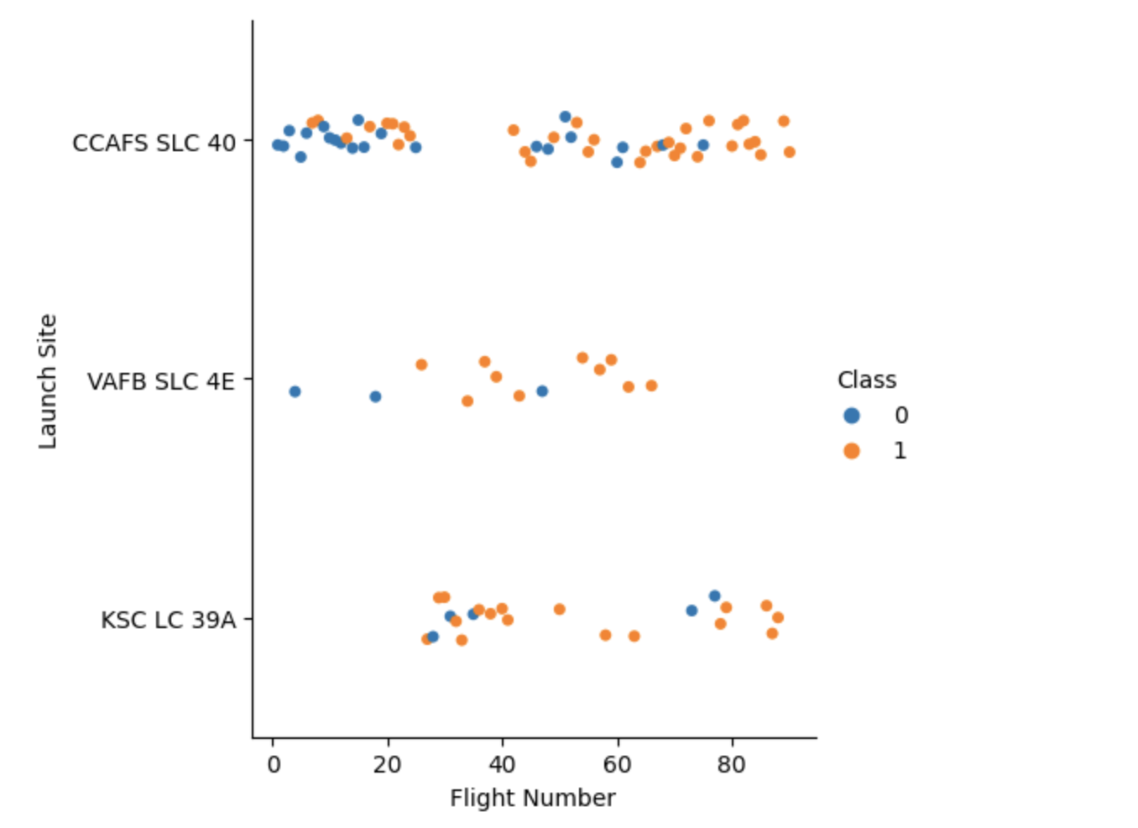
Flight Number vs. Launch Site
It appears that Launch sites VAFB and KSC had higher landing success rates than CCAFS
However, it also appears that landing success at CCAFS improved dramatically in later flights

Slide 19
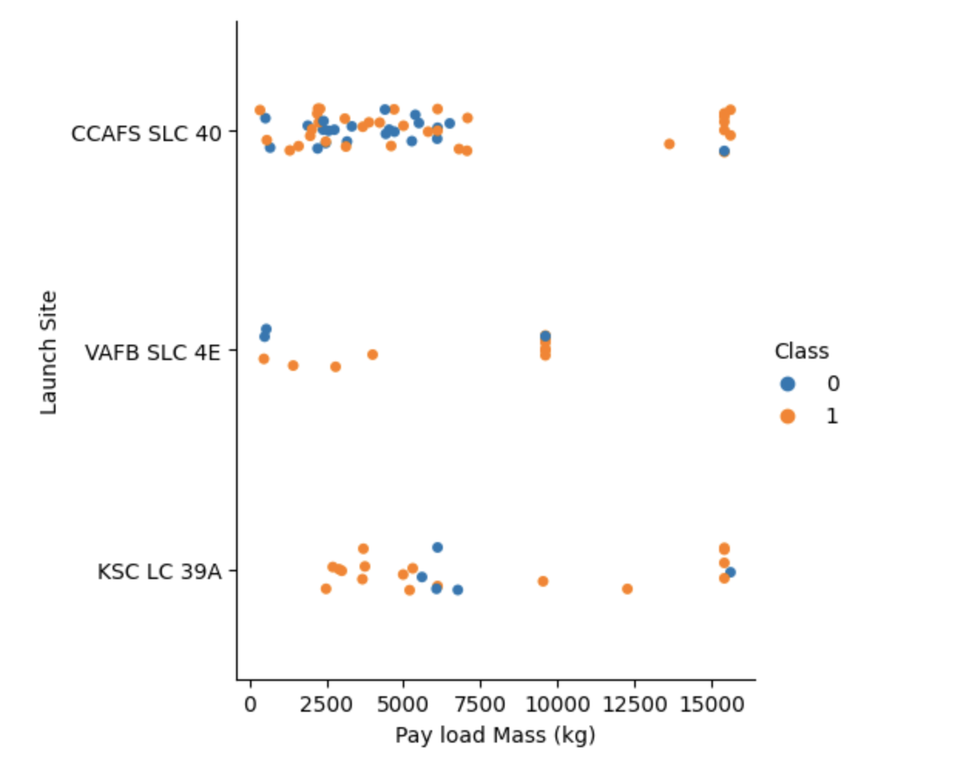
Payload vs. Launch Site
CCAFS had a higher percentage of success with Heavier payloads
VAFB did not have any payloads over 10,000 kg
Successful landing for KSC varied across payloads

Slide 20
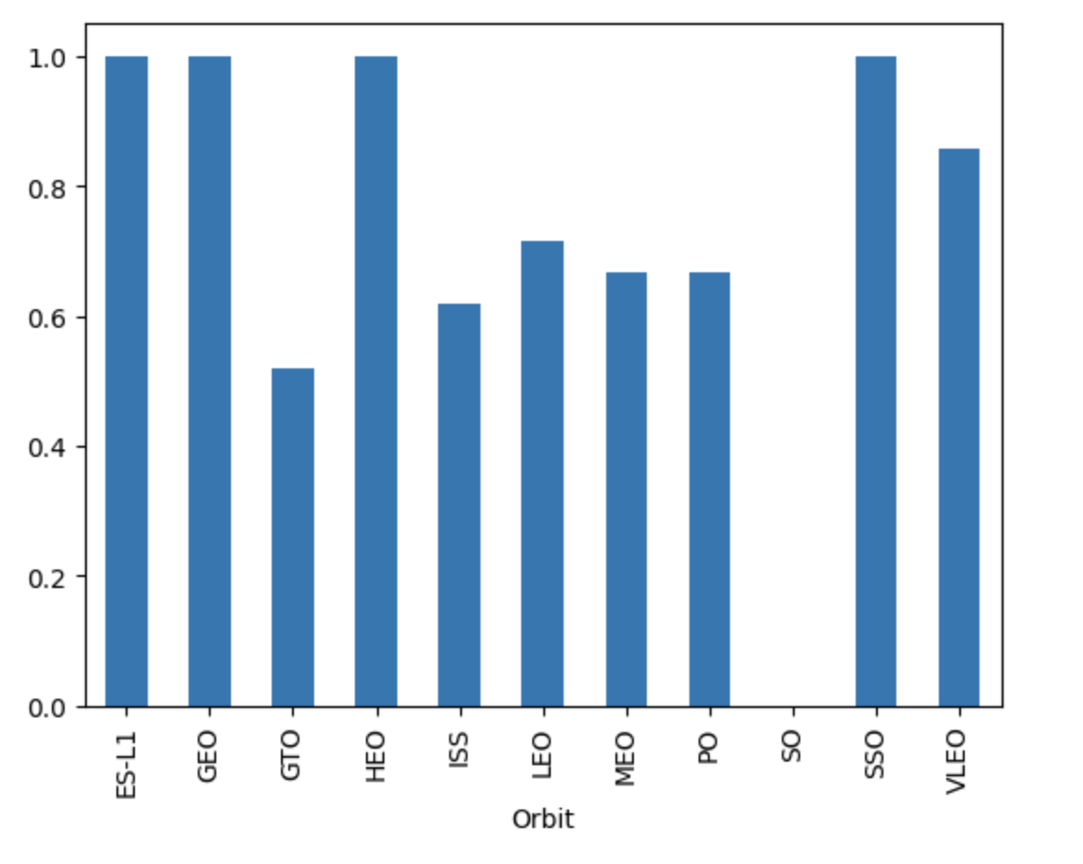
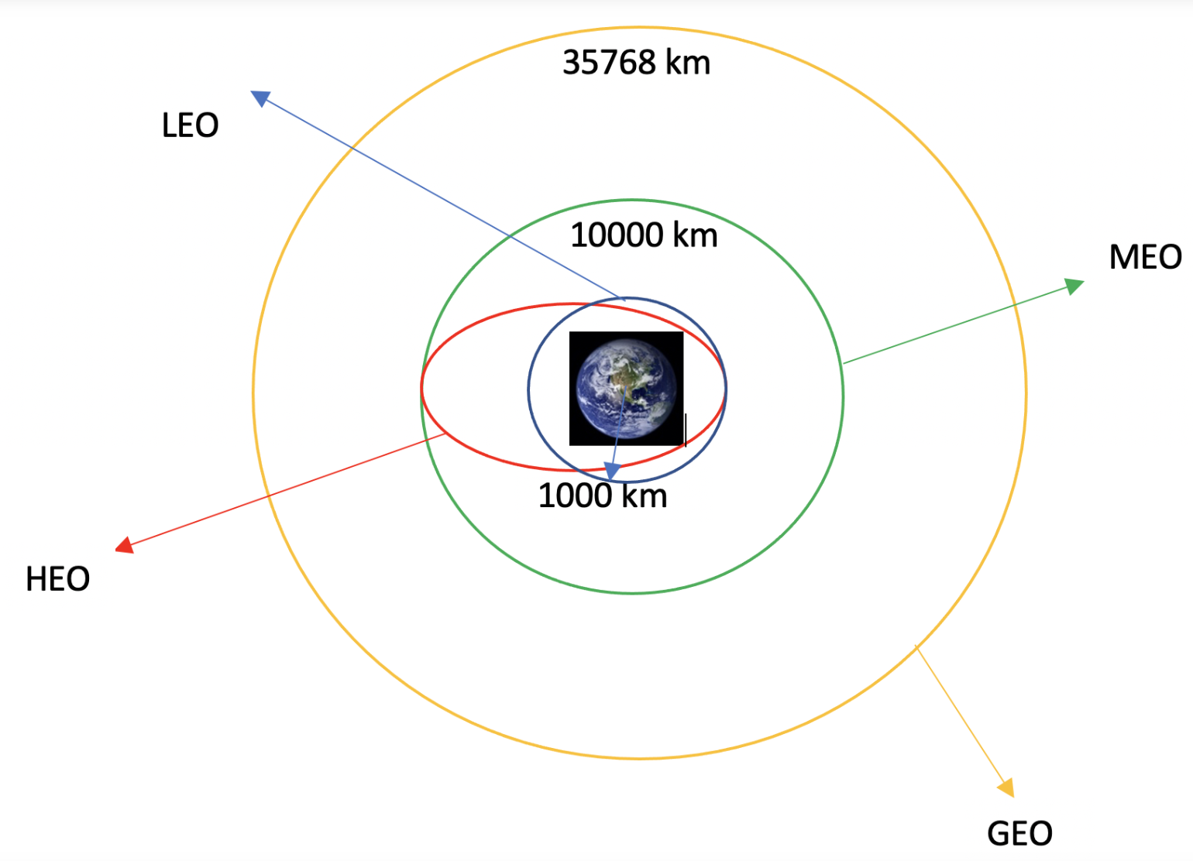
Success Rate vs. Orbit Type
It appears that the highest rates of landing success occurred for launches to:
ES-L1
GEO
HEO
SSO
VLEO
Given the variable nature of these orbits, it is unclear whether a relationship exists

Slide 21
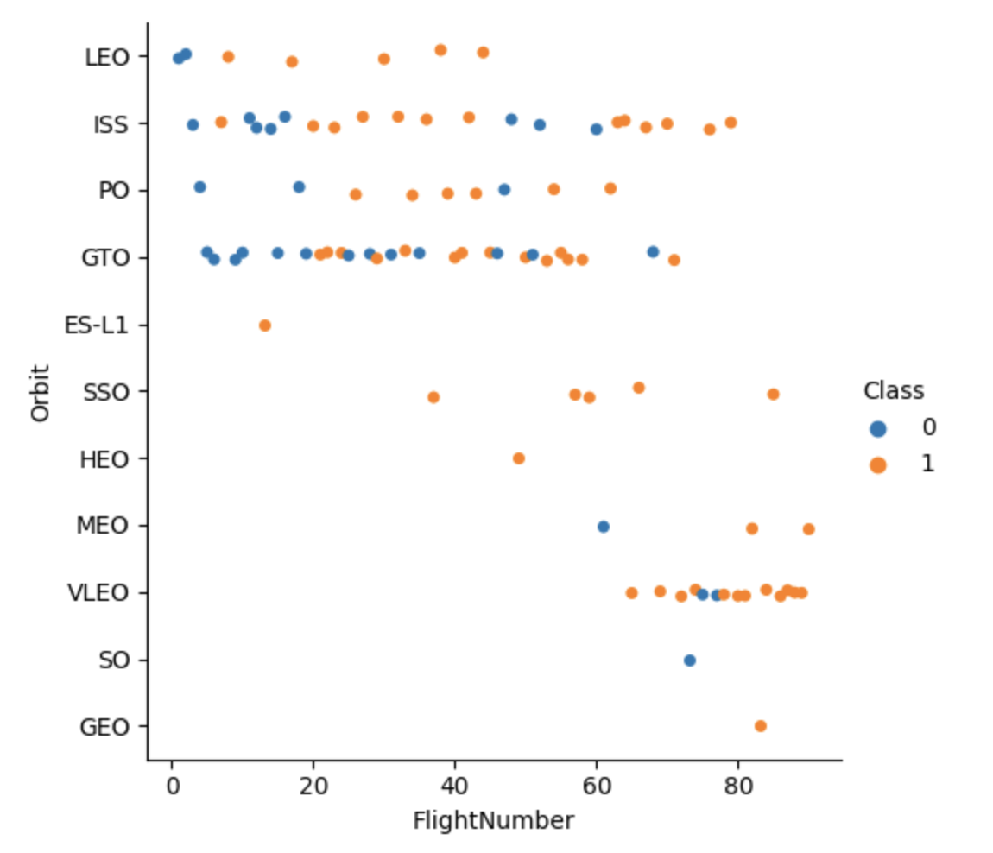
Flight Number vs. Orbit Type
It appears that early flights were focused on LEO, ISS, PO, and GTO orbits with varied success
Later flights explored more orbit types with increasing success

Slide 22
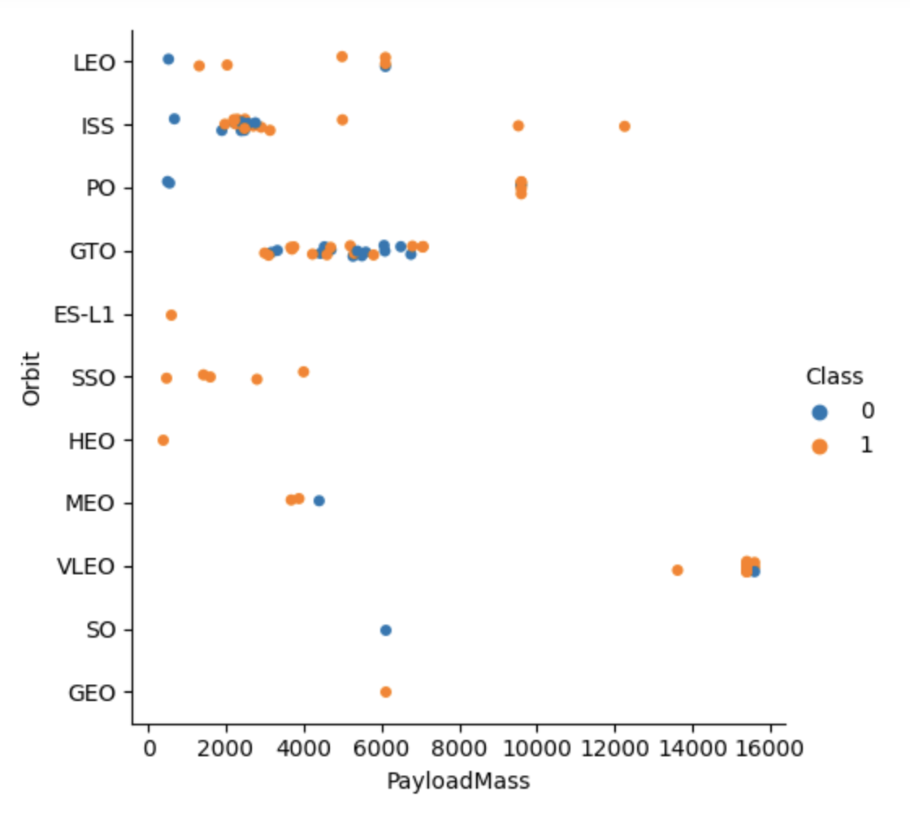
Payload vs. Orbit Type
It appears that lighter payload masses (<10K kg) were the focus of earlier orbit targets.
Later flights had success with heavier payloads, particularly at VLEO

Slide 23
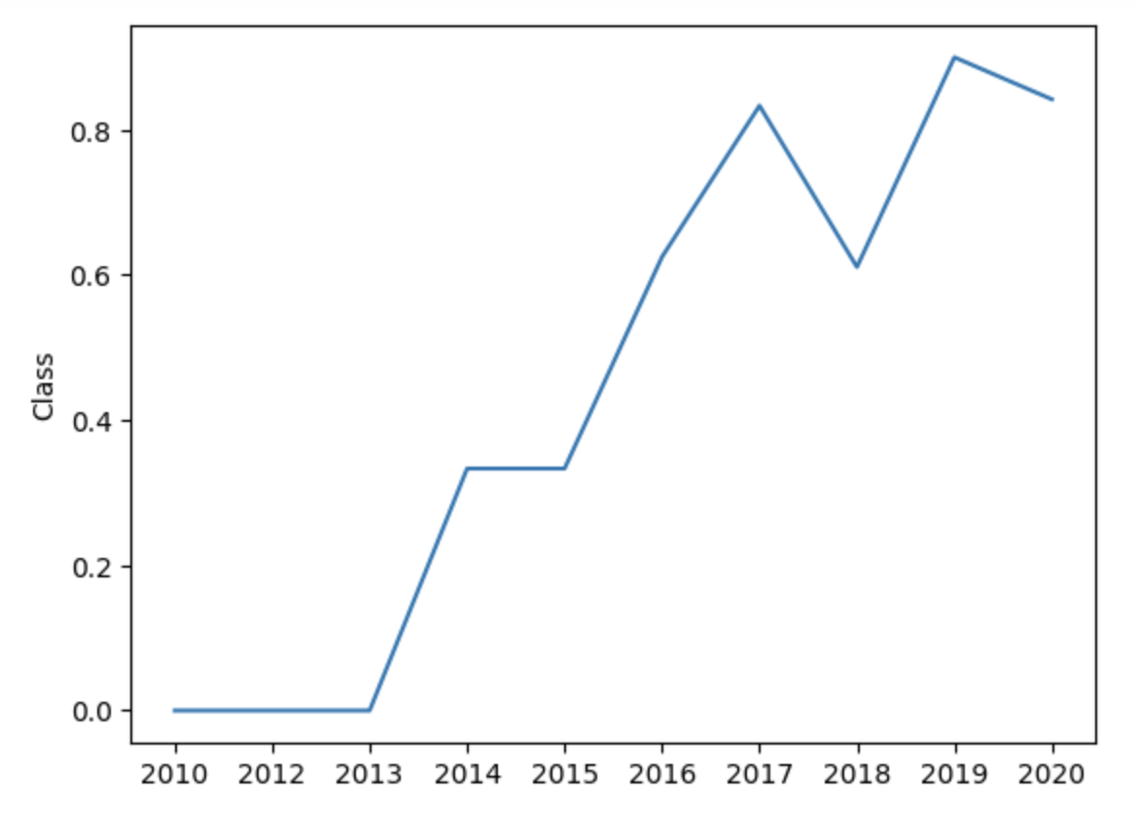
Launch Success Yearly Trend
Overall, the success rate increased since 2013

Slide 24
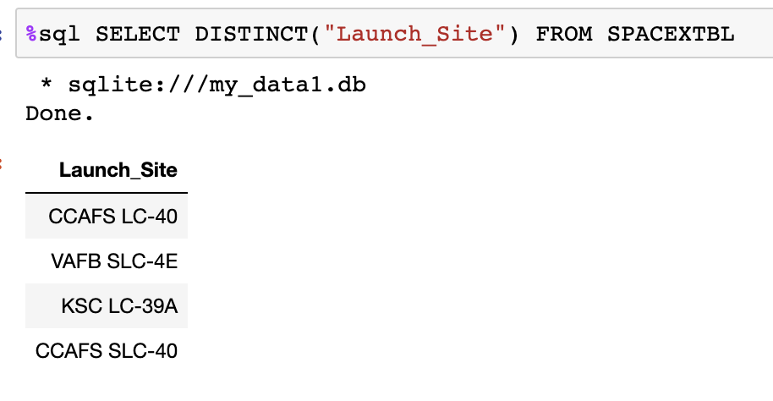
All Launch Site Names
Find the names of the unique launch sites

Slide 25
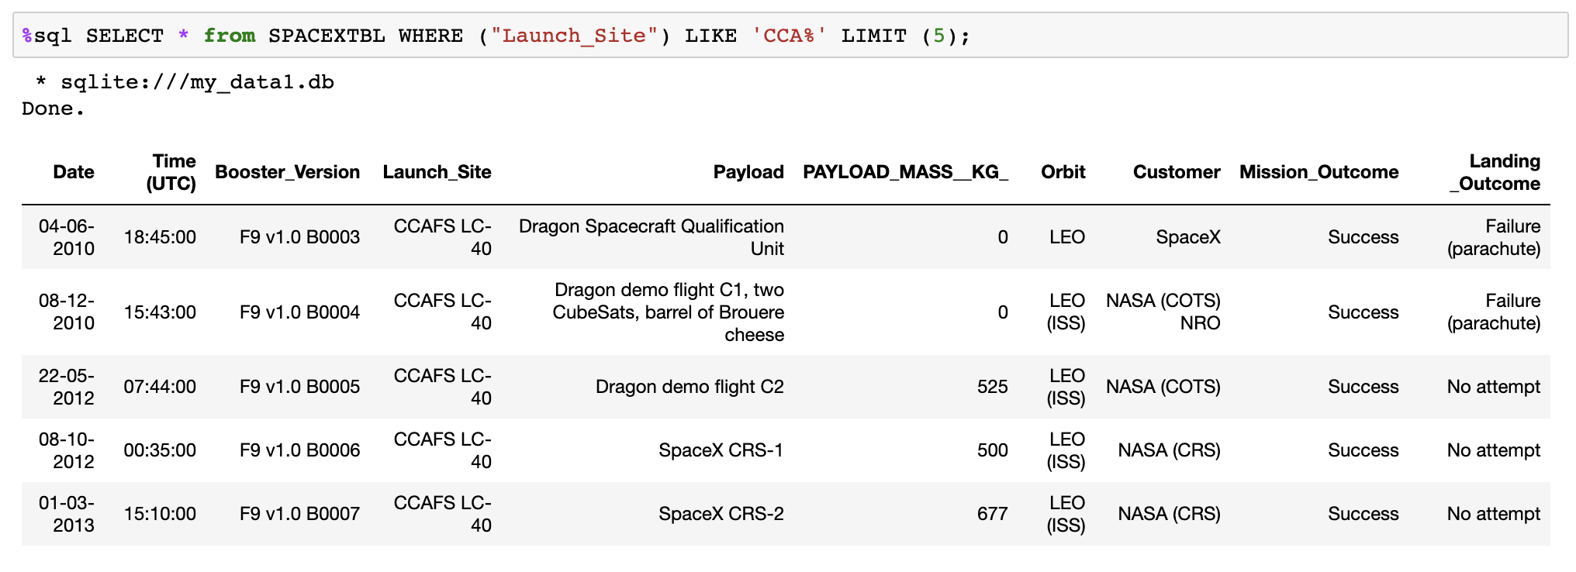
Launch Site Names Begin with 'CCA'
Find 5 records where launch sites begin with `CCA`

Slide 26
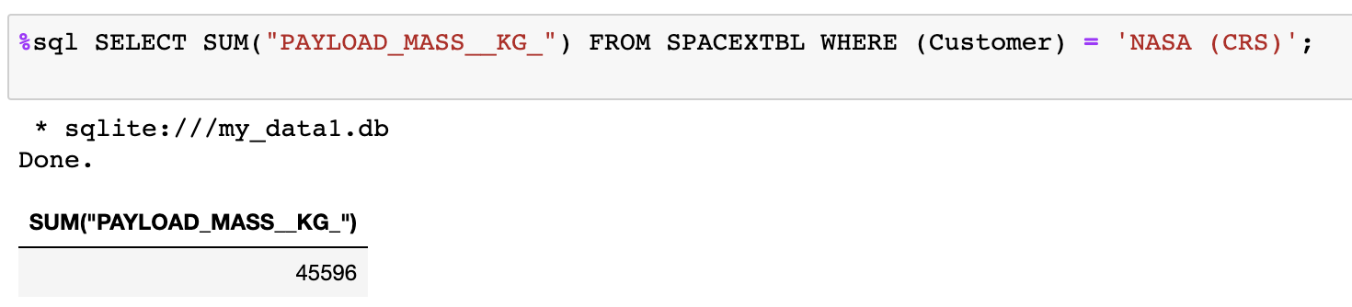
Total Payload Mass
Calculate the total payload carried by boosters from NASA

Slide 27
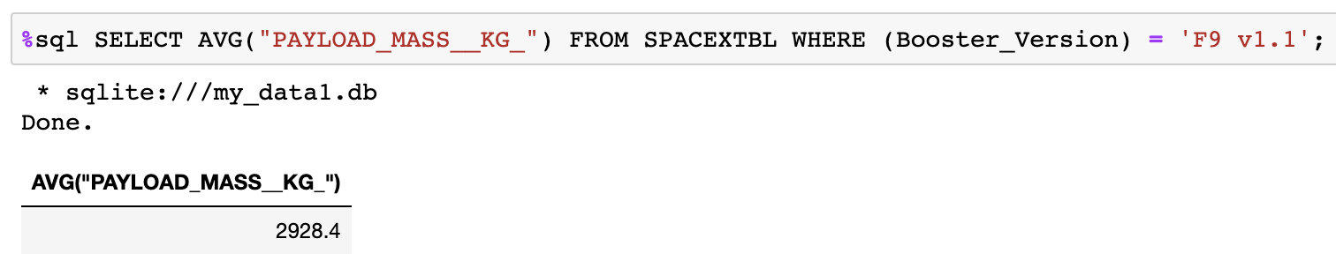
Average Payload Mass by F9 v1.1
Calculate the average payload mass carried by booster version F9 v1.1

Slide 28
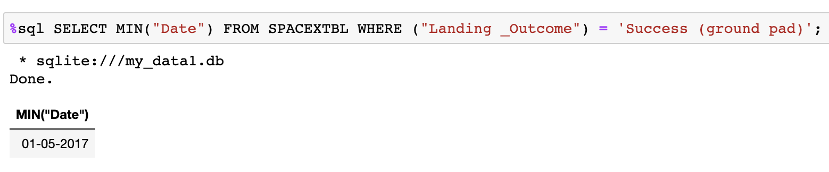
First Successful Ground Landing Date
Find the dates of the first successful landing outcome on ground pad

Slide 29
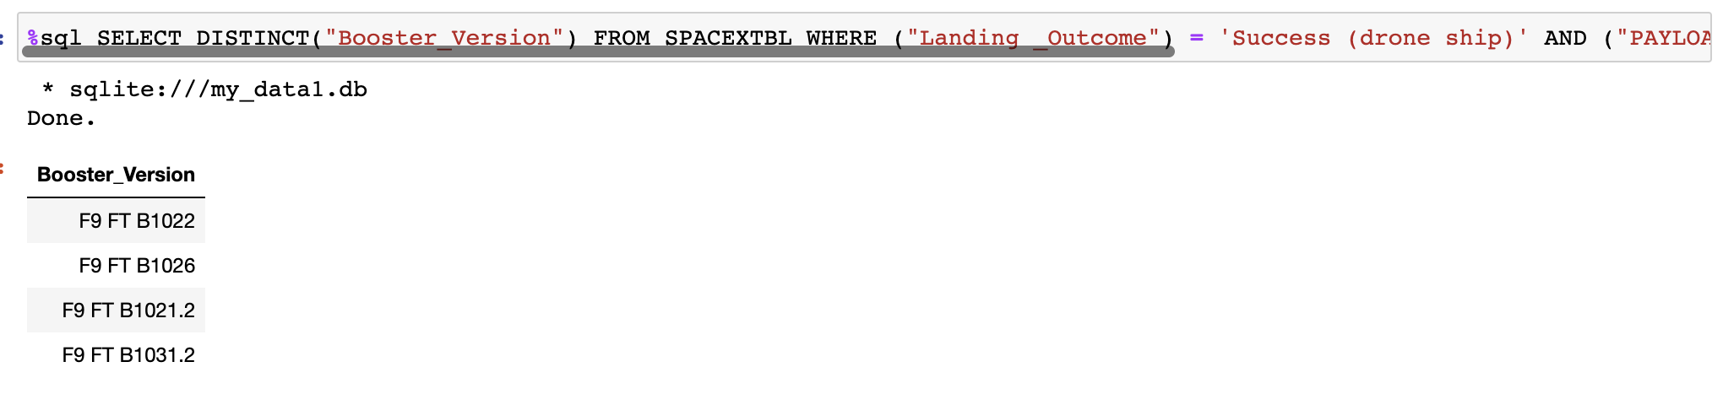
Successful Drone Ship Landing with Payload between 4000 and 6000
List the names of boosters which have successfully landed on drone ship and had payload mass greater than 4000 but less than 6000

Slide 30
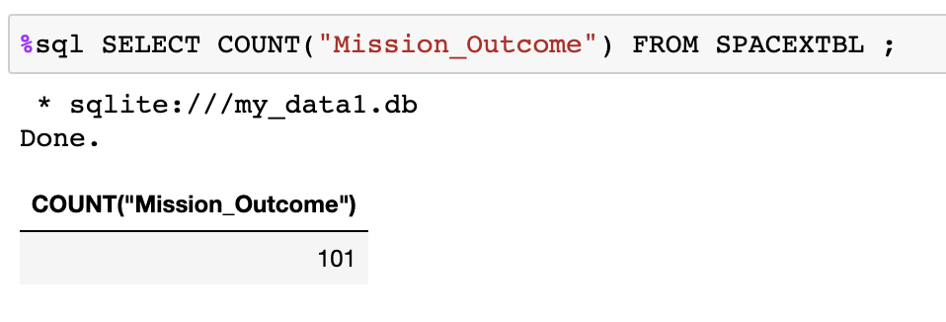
Total Number of Successful and Failure Mission Outcomes
Calculate the total number of successful and failure mission outcomes

Slide 31
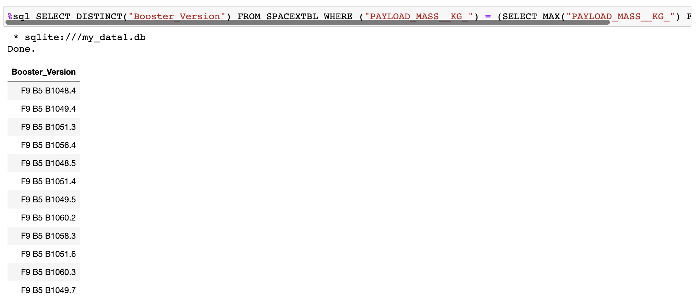
Boosters Carried Maximum Payload
List the names of the booster which have carried the maximum payload mass

Slide 32
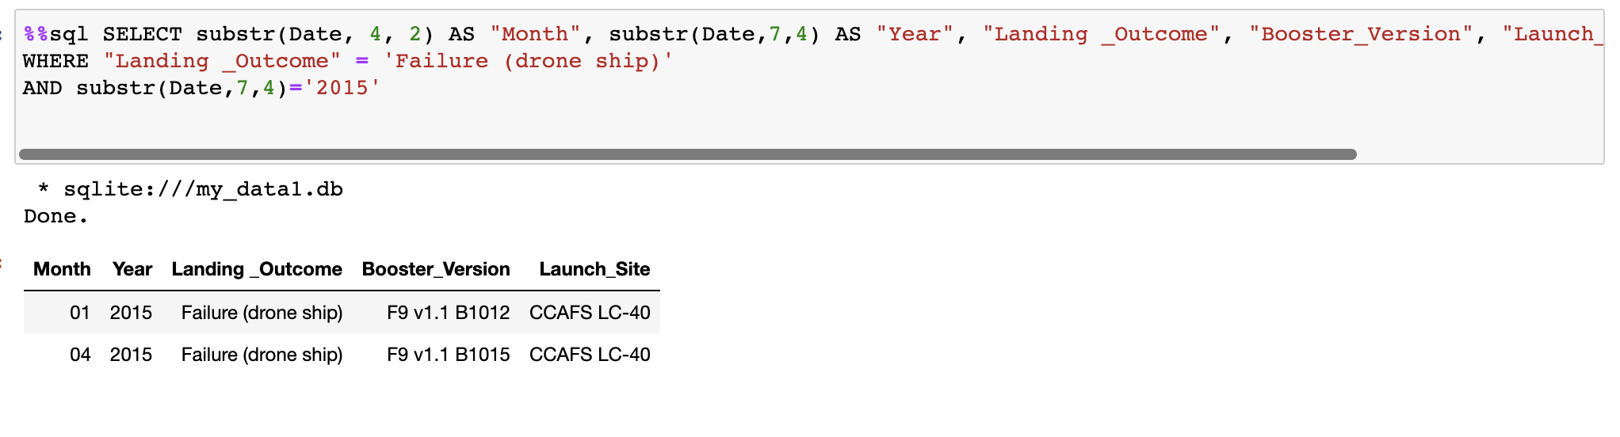
2015 Launch Records
List the failed landing_outcomes in drone ship, their booster versions, and launch site names for in year 2015

Slide 33
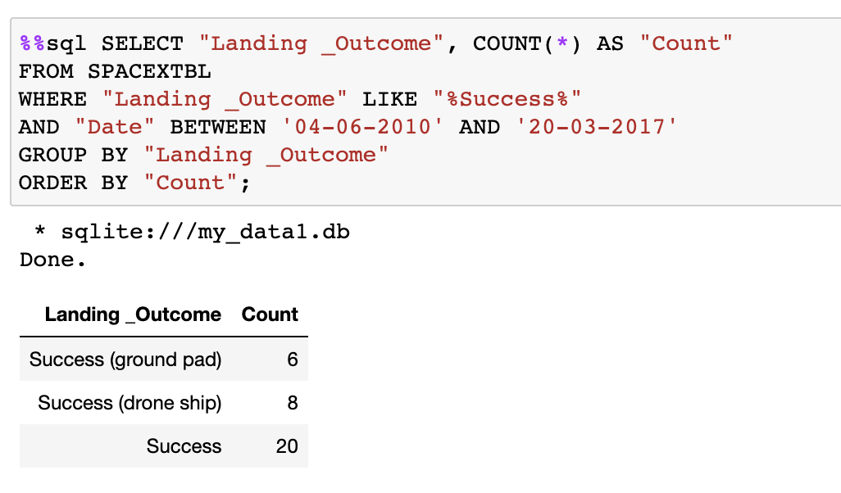
Rank Landing Outcomes Between 2010-06-04 and 2017-03-20
Rank the count of landing outcomes (such as Failure (drone ship) or Success (ground pad)) between the date 2010-06-04 and 2017-03-20

Slide 34

Section 3

Slide 35
<Folium Map Screenshot 1>
Replace <Folium map screenshot 1> title with an appropriate title
Explore the generated folium map and make a proper screenshot to include all launch sites’ location markers on a global map
Explain the important elements and findings on the screenshot

Slide 36
<Folium Map Screenshot 2>
Replace <Folium map screenshot 2> title with an appropriate title
Explore the folium map and make a proper screenshot to show the color-labeled launch outcomes on the map
Explain the important elements and findings on the screenshot

Slide 37
<Folium Map Screenshot 3>
Replace <Folium map screenshot 3> title with an appropriate title
Explore the generated folium map and show the screenshot of a selected launch site to its proximities such as railway, highway, coastline, with distance calculated and displayed
Explain the important elements and findings on the screenshot

Slide 38

Section 4

Slide 39
<Dashboard Screenshot 1>
Replace <Dashboard screenshot 1> title with an appropriate title
Show the screenshot of launch success count for all sites, in a piechart
Explain the important elements and findings on the screenshot

Slide 40
<Dashboard Screenshot 2>
Replace <Dashboard screenshot 2> title with an appropriate title
Show the screenshot of the piechart for the launch site with highest launch success ratio
Explain the important elements and findings on the screenshot

Slide 41
<Dashboard Screenshot 3>
Replace <Dashboard screenshot 3> title with an appropriate title
Show screenshots of Payload vs. Launch Outcome scatter plot for all sites, with different payload selected in the range slider
Explain the important elements and findings on the screenshot, such as which payload range or booster version have the largest success rate, etc.

Slide 42

Section 5

Slide 43
Classification Accuracy
Visualize the built model accuracy for all built classification models, in a bar chart
Find which model has the highest classification accuracy

Slide 44
Confusion Matrix
Show the confusion matrix of the best performing model with an explanation

Slide 45
Conclusions
Point 1
Point 2
Point 3
Point 4
…

Slide 46
Appendix
Include any relevant assets like Python code snippets, SQL queries, charts, Notebook outputs, or data sets that you may have created during this project

Slide 47


